Slide 1
Data Binding & Pipes

Slide 2

Component
DOM
EVENTS
PROPERTIES

Slide 3
Module Overview
Property binding
Handling events with event binding Handling input with two-way binding Transforming data with pipes

Slide 4
Application Architecture
Welcome Component
index.html
App Component
Product List Component
Star Component
Product Detail Component
Product Data Service

Slide 5
Property Binding
Element Property
Template Expression
<img [src]='product.imageUrl'>
<img src={{product.imageUrl}}>
<input type='text' [disabled]='isDisabled'/>
<img src='http://myImages.org/{{product.imageUrl}}'>

Slide 6
Property Binding
Template
Component
<h1>{{pageTitle}}</h1>
<img [src]='product.imageUrl'>
export class ListComponent { pageTitle: string = 'Product List'; products: any[] = [
{
productId: 2,
productName: "Garden Cart", productCode: "GDN-0023", releaseDate: "March 18, 2021", description: "Rolling garden cart", price: 32.99,
starRating: 4.2,
imageUrl: "assets/images/cart.png"
}, ...
];
}

Slide 7
Event Binding
Template
Component
<h1>{{pageTitle}}</h1>
<img [src]='product.imageUrl'>
<button (click)='toggleImage()'>
export class ListComponent { pageTitle: string = 'Product List'; products: any[] = […];
}
toggleImage(): void {…}
Event
Method

Slide 8

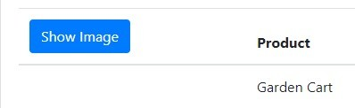
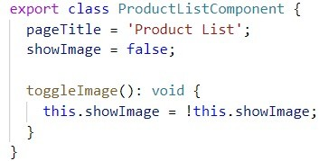
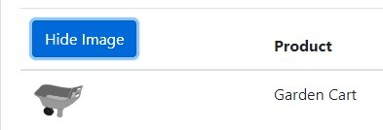

Change Detection

Slide 9
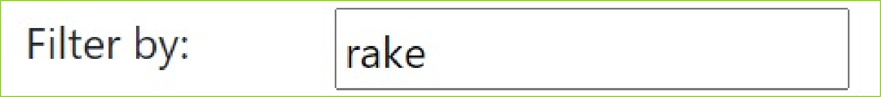
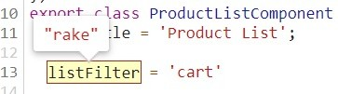

Two-way Binding
Template
Component
<div class='col-md-2'>Filter by:</div>
<div class='col-md-4'>
<input type='text' />
</div>
export class ListComponent { listFilter: string = 'cart';
}

Slide 10
Two-way Binding
Template
Component
<div class='col-md-2'>Filter by:</div>
<div class='col-md-4'>
<input type='text’
[(ngModel)]='listFilter'/>
</div>
export class ListComponent { listFilter: string = 'cart';
}

Slide 11
Two-way Binding
Template
Component
<div class='col-md-2'>Filter by:</div>
<div class='col-md-4'>
<input type='text’
[(ngModel)]='listFilter'/>
</div>
export class ListComponent { listFilter: string = 'cart';
}

Slide 12
Two-way Binding
Template
Component
<div class='col-md-2'>Filter by:</div>
<div class='col-md-4'>
<input type='text’
[(ngModel)]='listFilter'/>
</div>
export class ListComponent { listFilter: string = 'cart';
}

Slide 13
Two-way Binding
Template
Component
<div class='col-md-2'>Filter by:</div>
<div class='col-md-4'>
<input type='text’
[(ngModel)]='listFilter'/>
</div>
export class ListComponent { listFilter: string = 'cart';
}
[()]
Banana in a Box

Slide 14
AppModule
BrowserModule
AppComponent
ProductList - Component
Imports Exports Declarations Bootstrap

Slide 15
BrowserModule
FormsModule
AppModule
AppComponent
ProductList - Component
Imports Exports Declarations Bootstrap

Slide 16
Displaying Data with Binding
Template
Component
<tbody>
<tr *ngFor='let product of products'>
<td>
<img *ngIf='showImage' [src]='product.imageUrl'
[title]='product.productName' [style.width.px]='imageWidth'
[style.margin.px]='imageMargin'>
</td>
<td>{{ product.productName }}</td>
<td>{{ product.productCode }}</td>
<td>{{ product.releaseDate }}</td>
<td>{{ product.price }}</td>
<td>{{ product.starRating }}</td>
</tr>
</tbody>
export class ListComponent { pageTitle: string = 'Product List’; imageWidth: number = 50; imageMargin: number = 2; showImage: boolean = false; products: any[] = [
{
productId: 2,
productName: "Garden Cart", productCode: "GDN-0023", releaseDate: "March 18, 2021", description: "Rolling garden cart", price: 32.99,
starRating: 4.2,
imageUrl: "assets/images/cart.png"
}, ...
];
}

Slide 17



Transforming Data with Pipes
Transform bound properties before display
Built-in pipes: date, number, decimal, percent, currency, json, etc.
Custom pipes

Slide 18
Pipe Examples
{{ product.productCode | lowercase }}
<img [src]='product.imageUrl' [title]='product.productName | uppercase'>
{{ product.price | currency | lowercase }}
{{ product.price | currency:'USD':'symbol':'1.2-2' }}

Slide 19
Data Binding
Template
Component
<div class='card-header'>
{{pageTitle}}
</div>
@Component({
selector: 'pm-products',
templateURL: './product-list.component.html'
})
export class ProductListComponent { pageTitle: string = 'Product List’; imageWidth = 50;
imageMargin = 2;
showImage = false;
listFilter: string = 'cart'; products: any[] = […];
toggleImage(): void {…}
<img *ngIf='showImage' src={{product.imageUrl}} [title]='product.productName' [style.width.px]='imageWidth' [style.margin.px]='imageMargin'>
<button class='btn btn-primary' (click)='toggleImage()'>
{{showImage ? 'Hide' : 'Show'}} Image
</button>
<div class='col-md-2'>Filter by:</div>
<div class='col-md-4'>
<input type='text'
[(ngModel)]='listFilter' />
</div>
}

Slide 20
Data Binding
DOM
Component
Interpolation: {{pageTitle}}
Property Binding: <img [src]='product.imageUrl'>
Event Binding: <button (click)='toggleImage()'>
Two-Way Binding: <input [(ngModel)]='listFilter'/>

Slide 21

Data Binding Checklist: ngModel
product-list.component.html
<div class='col-md-4'>
<input type='text' [(ngModel)]='listFilter' />
</div>
app.module.ts
@NgModule({ imports: [
BrowserModule, FormsModule ],
declarations: [ AppComponent, ProductListComponent ],
bootstrap: [ AppComponent ]
})
export class AppModule { }

Slide 22
Data Binding Checklist: Pipes
Pipe character |
Pipe name
Pipe parameters
- Separated with colons
Example
{{ product.price | currency:'USD':'symbol':'1.2-2' }}

Slide 23
Application Architecture
Welcome Component
index.html
App Component
Product List Component
Star Component
Product Detail Component
Product Data Service

Slide 24

Coming up next …
More on Components

